Slide 1
NIEM 303
Assemble, Publish, & Implement an IEPD
Presenter Name
Organization
Date
TRAINING

Slide 2
Course Objectives
Welcome to the NIEM 303: Assemble, Publish, & Implement an IEPD
This course will enable participants to assemble an IEPD, publish it to a repository, and implement it in an information exchange
By the end of this course, you will be able to:
Create and analyze an IEPD Master Document
Assemble an IEPD package with its associated artifacts
Publish an IEPD to an online repository and recognize the importance of doing so
DURATION
3 Hour
PREREQUISITES
NIEM 302 (Develop and Validate an IEPD)
Participants should also have a strong XML knowledge to understand the concepts presented in this course.

Slide 3
Course Agenda
Concept Refresh
Assemble & Document
Review an IEPD
Publish & Implement an IEPD
Assessment

Slide 4
Concept Refresh
Course Progress
0% complete

Slide 5
Module 1: Concept Refresh
Welcome to Module 1: Concept Refresh
This module will provide a refresher of basic NIEM concepts covered in previous courses.
At the end of this module, you will be able to:
Describe each phase of the IEPD lifecycle and associated artifacts

Slide 6
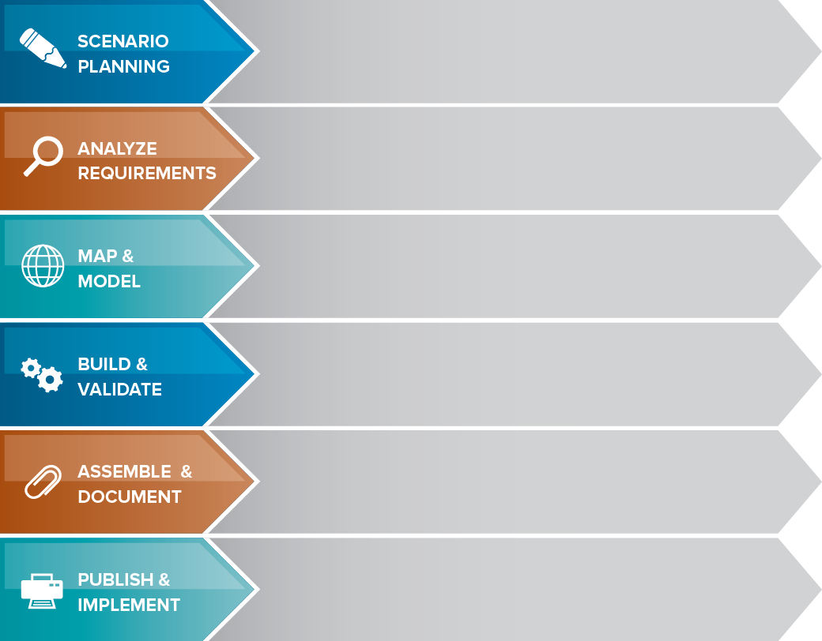
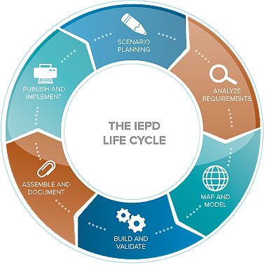
The IEPD lifecycle
Review background, assess resource impact, understand business context, and identify information exchange business scenarios
Selected information exchange scenario is further elaborated to understand and document the business context and data requirements
Create an exchange content model based on information exchange requirements. The Exchange Content Model is then mapped to NIEM.
Create a set of exchange-specific NIEM conformant XML schemas that implement the data model created for the exchange
Prepare and package all related files for this IEPD into a single self‐contained, self-documented, portable archive file
Implement the IEPD into production as well as publish the IEPD for search, discovery, and reuse.
6

Slide 7
The IEPD Artifacts
The following includes the required and recommended artifacts associated with each phase of the IEPD Lifecycle.
Business Processes Diagrams
Use Case Diagrams
Sequence Diagrams
IEPDs contain both required, recommended, and optional artifacts
Required:
Bold and Blue
Optional:
Plain
Note:
Best practices for most organizations include many of the artifacts listed here
Business Rules
Business Requirements
Exchange Content Model
Mapping Document
Subset Schema
Exchange Schema
Wantlist
Constraint Schema
Extension Schema
Reference Schema
XML Stylesheets
Master Document
Catalog
Change Log
Sample XML Instances
No required artifacts. Publish the IEPD to a repository and implement the exchange
7

Slide 8
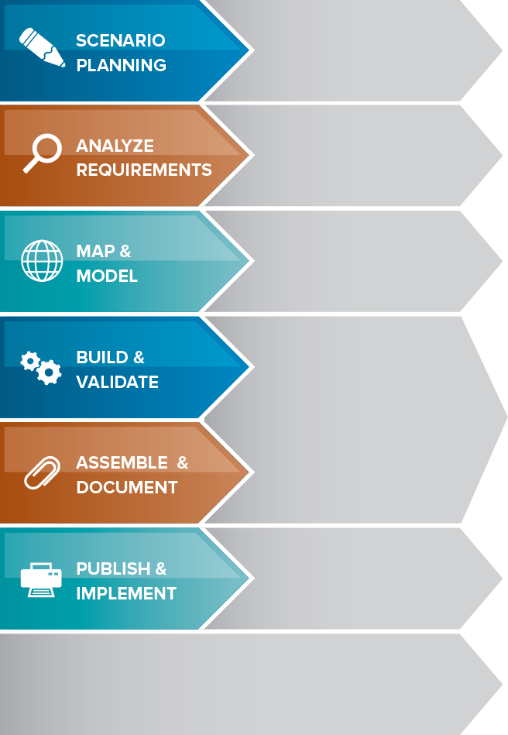
Systems Development Life Cycle
The following includes the phases of the Systems Development Life Cycle as they align with the IEPD Lifecycle.
Plan
Develop high level scope and goals of intended system
Requirements
Analyze goals and break them down into exact requirements
The Systems Development Life Cycle (SDLC) is a common methodology used for creating information systems
The IEPD Lifecycle aligns closely with the phases of the SDLC
Design
Transform requirements into detailed system capabilities
Develop
Develop system per design specifications
Implement
Test and deploy system and develop future plan
Maintain
Sustain system per future plan and eventually move to disposition

Slide 9
Module 1: Knowledge Check 1
Arrange the phases of the IEPD Lifecycle in the correct sequential order.
1
Analyze Requirements
2
Map and Model
3
Assemble and Document
4
Publish and Implement
5
Build and Validate
6
Scenario Planning

Slide 10
Module 1: Summary
You have completed Module 1: Concept Refresh
You should now be able to:
Describe the different phases of the IEPD Lifecycle and associated artifacts

Slide 11
Assemble & Document an IEPD
Course Progress
20% complete

Slide 12
Module 2: Assemble & Document an IEPD
Welcome to Module 2: Assemble & Document an IEPD
This module will be presented in the following parts:
2.1: IEPD Artifacts
2.2: IEPD Master Document, Change Log, Catalog
2.3: Additional IEPD Artifacts
2.4: Packaging and Assembling an IEPD

Slide 13
Module 2.1: IEPD Artifacts
At the end of this module, you’ll be able to:
List the required & optional IEPD artifacts for a NIEM-conformant exchange
List the document-based IEPD artifacts

Slide 14
Required & Optional IEPD Artifacts
The NIEM Model Package Description (MPD) Specification, available at NIEM.gov/references, lists common IEPD required and optional artifacts.
 | Required Artifacts | Optional Artifacts
Exchange Files | Subset Schema Exchange Schema Sample XML Instance Reference Schema | Constraint Schema Extension Schema Stylesheet Wantlist
Models | None Required | Exchange Content Model Use Case Diagram Business Process Diagram Sequence Diagram
Documentation | Master Document Change Log Catalog | Business Rules Business Requirements Mapping Document

Slide 15
Document-Based IEPD Artifacts
Document-based artifacts are required to provide context and discoverability of the IEPD
Master Document
The IEPD Master Document captures all of the business and functional aspects of the exchange. You can also find detailed information about the exchange, including the IEPD artifacts
Change Log
The IEPD Change Log records updates made to the IEPD. The IEPD metadata is stored in the catalog file.
Catalog
The IEPD catalog identifies every artifact, its relative path name, file type, and purpose. This enables a machine to find every artifact regardless of its location within an MPD, specifically an IEPD, and know exactly what it is used for, and therefore, how to process it

Slide 16
Module 2.2: IEPD Master Document, Change Log, Catalog
At the end of this module, you’ll be able to:
Define what the IEPD Master Document is
Understand how to create an IEPD Master Document
Define the IEPD Change Log
Define the IEPD Catalog

Slide 17
What is an IEPD Master Document?
A master document that contains detailed business and technical information about an information exchange
Used to provide an overview of an information exchange and explain the design decisions that were made in the development of the information exchange
Provides human-readable context for an exchange
Divided into sections for each of the different areas that describe an information exchange (use cases, requirements, exchange content model, etc.)
Developed throughout the course of the IEPD Lifecycle

Slide 18
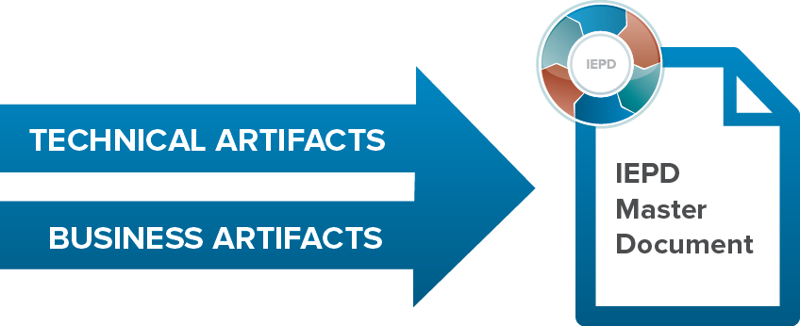
Creation of an IEPD Master Document
As a starting point, logically organize the master document in chronological order of the development artifacts
Existing IEPD master documents can be used as a general guide
Some organizations have specific requirements concerning the IEPD master document
Generally includes all models and documentation artifacts included in an IEPD but no exchange files or XML code

Slide 19
Sample Table of Contents
A NIEM IEPD master document should (at a minimum) describe the IEPD purpose, scope, business value, exchange information, senders/receivers, interactions, and references to other documentation.
This table of content is an example
Executive Summary…………………... | 1
<Name> Information Exchange……... | 2
Overview of the <Name> Exchange Exchange Partner Interaction
Business Models………………………. | 4
Business Rules and Requirements… | 7
Exchange Content Model…………….. | 7
Development Information……………. | 8
IEPD Definition Tools and Methodologies Testing and Conformance
Appendices………………………………… | 11
List if IEPD Artifacts IEPD Catalog

Slide 20
What is an IEPD Change Log?
A document that records modifications made to an IEPD, the developer of those changes, the change date, and the version number. IEPD change log requirements are less strict than NIEM Domain Update, Core Updates, and Release Change Logs.
Required as part of the IEPD
Must reside in the root directory of the IEPD
Can be an independent file in the IEPD
Must begin with the substring “changelog”
Should include as much detail as possible about the changes
Change Log
Version | Date | Description of Changes | Author
1.0 | 2/2/03 | Original Version | OCIO
1.1 | 4/16/03 | Added new elements to subset schema | Sarah D.
2.0 | 12/5/04 | Updated requirements and constraint schema | Sarah D.

Slide 21
What is an IEPD Catalog?
Every NIEM IEPD describes itself through a mandatory catalog artifact. A catalog is a multi-purpose XML file containing metadata that describes an IEPD’s
Unique identification
Basic descriptive characteristic
Directory structure and artifacts
Lineage and relationships to other IEPDs
This metadata is designed to be the minimal information required to facilitate human understanding, tool support, and machine processing.
Please see the current version of the MPD Specification available on NIEM.gov for additional information.

Slide 22
Module 2.3: ADDITIONAL IEPD ARTIFACTS
At the end of this module, you’ll be able to:
Identify additional artifacts that an organization may add to an IEPD

Slide 23
Additional IEPD Artifacts
Although an IEPD generally consists of the required and the optional artifacts identified by NIEM, some organizations and exchange developers may decide to add additional artifacts to the IEPD. This might be because:
An organization may have IEPD development requirements in place
In general, more artifacts and better documentation increases the quality of an IEPD
 | Additional Artifacts
Exchange Files | WSDL Definitions XML Instance Examples | SOAP Message Files
Documentation | Memorandums of Agreement Methodology and Tools Testing and Conformance | Best practices Extension Information Endorsement Letters Implementation Methods

Slide 24
Module 2.4: packaging and assembling an iepd
At the end of this module, you’ll be able to:
Explain the steps for packaging an IEPD
Provide an example of the IEPD folder structure
Describe the steps involved in assembling the final IEPD package

Slide 25
How do you package an IEPD?
An IEPD is a single, encapsulated archive that contains all of the necessary artifacts that define an information exchange
Different organizations may have different requirements for artifacts and structure
The standard you use, whether it is an internal or external organizational standard, should include a consistent naming and folder structure. The guidelines laid out in the Model Package Description (MPD) Specification should be used as a guideline

Slide 26
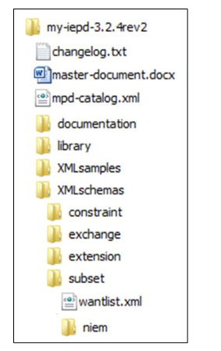
An Example of the IEPD Folder Structure
A standardized file structure promotes consistency, while creating a logical navigation through a large number of IEPD artifacts. Moreover, this consistency enables a greater degree of discovery and IEPD reuse because you can easily access information in a structured and uniform manner. As such:
Depending on the organization, IEPDs typically have a consistent folder structure, which allows for logical navigation of IEPD artifacts
Adopting an organizational standard for the structure and content of IEPDs will promote their discovery and reuse
The diagram to the right is an example of an IEPD folder structure
The catalog is intended to enable IEPD developers to locate artifacts in a directory and label them as specific IEPD artifacts, no matter where the exist in that directory

Slide 27
IEPD Assembly
Once all IEPD artifacts have been compiled, the next step is to properly name, file, and archive the final package
Name
File
Archive
Name each artifact for your exchange with a consistent naming convention
File each artifact in a logical, consistent folder structure
Archive the file structure, including artifacts, into the final package
Organizational standards for each of these steps will increase the discoverability and reusability of IEPDs

Slide 28
Module 2: Knowledge Check 1
What are the required artifacts for Documentation while developing an IEPD package?
A. Master Document
B. Subset Schema
C. Change Log
D. IEPD Catalog

Slide 29
Module 2: Summary
You have completed Module 2: Assemble and Document an IEPD
You should now be able to:
List the required and optional artifacts for a NIEM information exchange
List the document-based IEPD artifacts
Define what the IEPD Master Document is
Understand how to create an IEPD Master Document
Define what the IEPD Change Log is
Define what the IEPD Catalog is
Identify additional artifact that an organization may add to an IEPD
Explain the steps for packaging an IEPD
Understand the IEPD folder structure
Describe the steps involved in assembling the final IEPD package

Slide 30
Review an IEPD
Course Progress
40% complete

Slide 31
Module 3: Review an IEPD
Welcome to Module 3: Review an IEPD
At the end of this module, you will be able to:
Explain the value of a review process

Slide 32
Value of a Review Process
An IEPD Review Process is a good practice to maintain a consistent standard of quality in documents that are accepted for publication in support of organizational information sharing initiatives
An IEPD Review Process…
Promotes IEPD Artifact consistency
Minimizes redundant or inconsistent details between IEPDs
Increases higher quality IEPD delivery
Increases confidence in IEPD information
Increases a standardized information sharing environment
Promotes an ease of search, discovery and reuse of IEPDs
A review process will help to decrease the occurrence of published IEPDs that are difficult to reuse. Peer participation in an IEPD review group also increases individual knowledge of information exchanges and will promote accountability in verifying that the exchange meets established requirements.

Slide 33
Use a Review Checklist
The IEPD should follow the requirements of the MPD Specification available on the NIEM website. It is a best practice to create a checklist for review to ensure these requirements and additional organizational guidelines are followed.
Many organizations use a checklist to ensure that an IEPD meets pre-defined requirements
Checklists provide the reviewing authority with a consistent way to provide feedback to IEPD developers
Below are a few examples of general requirements that could be added to an IEPD checklist
Master Document contains documentation necessary to effectively describe the information exchange
Exchange Content Model file is included, is embedded in the master document, and accurately represents the XML code in the schemas
Catalog XML artifact validates with the NIEM Model Package Description (MPD) catalog schema (XSD) and resides in the root directory of the MPD bearing the file name “mpd-catalog.xml”
Change Log IEPD change log file is included in the root directory of the IEPD, begins with the substring “changelog,” and records changes to previous IEPD schemas that are represented

Slide 34
IEPD Peer Review Process Example
Some organizations use an IEPD Peer Review Process to establish a standard process for reviewing IEPDs
Submit
Preliminary Review
Detailed Review
Accept & Publish
IEPD is provided to the reviewing group for review
IEPD author briefs the reviewing group on the IEPD
IEPD is critically assessed by member(s) of the reviewing group
Author provides assistance to the review process, if necessary
IEPD is reviewed against business requirements and NIEM specifications
The IEPD is accepted by the review group
For reuse: IEPD should be published to an online repository to avoid duplication

Slide 35
Responsibilities of IEPD Developer
Responsibilities exist within the IEPD review process for the IEPD developer, including:
IEPD Developer
Review the IEPD Package prior to submission to check for conformance
Submit IEPD to the governing authority for review
Provide brief overview of IEPD to the governing authority, if necessary, to answer any questions and clear any concerns with the submission of the package.
Coordinate with review team to include all recommended changes that are agreed upon in the revised IEPD
Submit revised IEPD for reviewing authority, if applicable

Slide 36
Responsibilities of Review Authority
Responsibilities exist within the IEPD review process for the reviewing authority, or review team, including:
Reviewing Authority
Review IEPDs in accordance with organizational guidelines
Coordinate with IEPD developer(s) during the review process to incorporate all feedback into the document as necessary
Coordinate status updates to the IEPD developer and best practice briefings for the NIEM community of interest
Submit the finalized IEPD to exchange stakeholders
Publish to internal or public repository for reuse
After publication, the information exchange must be implemented. Implementation of the information exchange, along with proper approval and publishing, are all important to information exchange adoption and discovery across partners.

Slide 37
Module 3: Summary
You have completed Module 3: Review an IEPD
You should now be able to:
Explain the value of the IEPD review process

Slide 38
Publish & Implement IEPD
Course Progress
60% complete

Slide 39
Module 4: Publish and Implement an IEPD
Welcome to Module 4: Publish and Implement an IEPD
At the end of this module, you’ll be able to:
Explain the value proposition of publishing an IEPD
Identify and explain characteristics of various IEPD repositories
List the steps in the IEPD publishing lifecycle
Identify common ways to implement an exchange

Slide 40
Value Proposition of Publication
Publication of an IEPD allows for future search, discovery, and reuse of the IEPD in other information exchanges.
Discovery and reuse of IEPDs:
Leads to Greater Understanding of Exchanges
Reduces Development Effort
Increases Reusable Content
Increased Collaboration
The search, discovery, and reuse of IEPDs are necessary for effective information exchange across organizations. IEPD Publication leads to an increase in each of these value propositions as it allows you to search for information that you may need without having to recreate it.

Slide 41
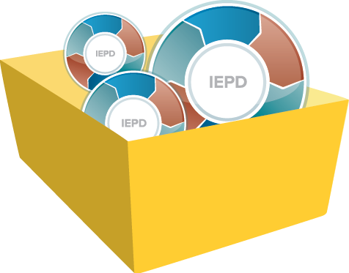
IEPD Repositories
IEPD Repositories are online systems used to store IEPDs and enable search, discovery, and reuse of IEPDs
Publish an IEPD to all repositories that are relevant to the exchange; the more exposure the better
If an organization is developing a significant number of IEPDs, the development of a “local” repository may add significant value
Repositories do not have to be limited to IEPDs; other systems integration artifacts can be included if relevant to the exchange
If the IEPD is being developed based on a grant, the publication to a repository may be a REQUIRED step
Available IEPD Repositories:
Organizational Exchange Repository
IEPD Clearinghouse
NIEM.gov Online Repository

Slide 42
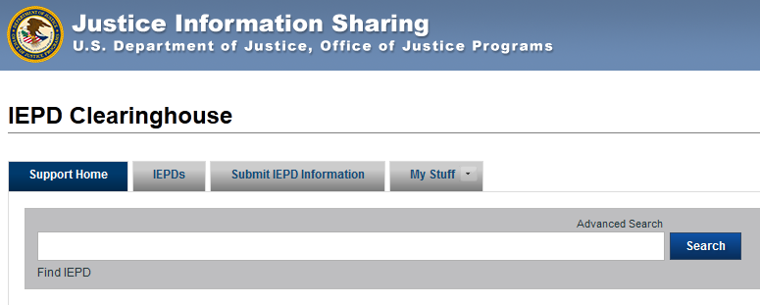
NIEM Tools Catalog: IEPD Clearinghouse
The IEPD Clearinghouse:
Provides information about the IEPD, however, the physical IEPD is stored by the IEPD developer
Contains a large number of mature, NIEM-conformant IEPDs
https://www.niem.gov/OJPiepdclearinghouse

Slide 43
IEPD Publishing Lifecycle
Some repositories have a publishing “lifecycle” that places IEPDs in one of three states.
Staged
Published
Deactivated
The IEPD developer has uploaded artifacts to the repository, but not yet published them.
The IEPD developer has made the IEPD available for search and discovery.
In the Deactivated state, the IEPD has been removed from public viewing. Only those IEPDs with a published state are searchable.
Processes may exist that guide IEPD developers in managing the workflow and publication process

Slide 44
Implementing your niem exchange
NIEM Does:
Define XML instance document format and structure.
NIEM Does Not:
Define implementation specifications Specify how a document is transmitted, but may employ encryption, Zip, Efficient XML Interchange (EXI), etc.

Slide 45
Example: Implementing NIEM
There are many ways to implement NIEM
Two common implementation examples include:
Message Queue: An organization can store NIEM-conformant XML instances within a message queue during its response to a stakeholder’s information request service.
Web Services: An organization can embed a NIEM conformant schema into a new or existing Web Service and perform an electronic transfer with one or more exchange partners potentially through a Service Oriented Architecture based environment.

Slide 46
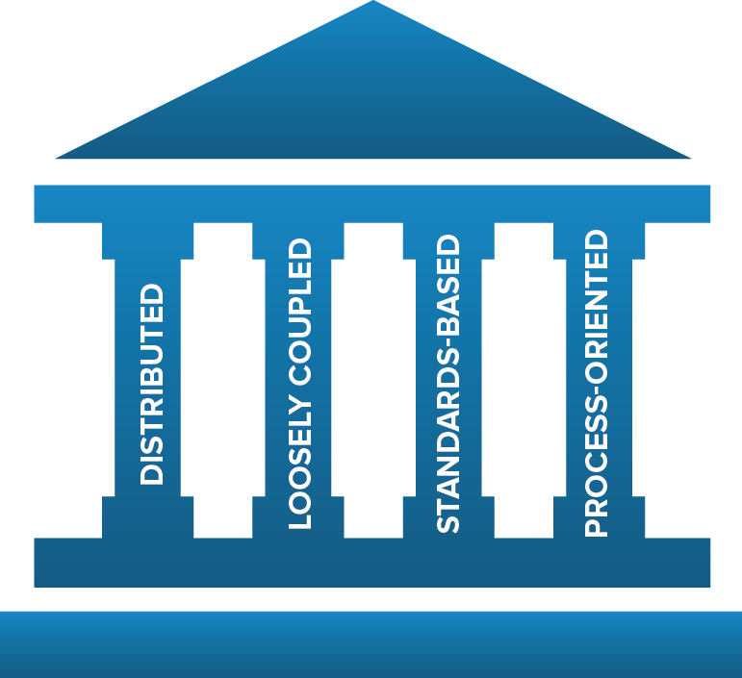
Example: SOA Implementation
Service Oriented Architecture (SOA) is an architectural style whose goal is to achieve loose coupling among interacting software agents.
Standards-Based:
NIEM provides the standard for data layer interoperability among services in SOA
NIEM can decrease development time of new services in SOA through reuse of similar IEPDs
NIEM can be used to standardize and structure the messages passed between services in SOA

Slide 47
Best practices for implementation
Systems on either side of the exchange can use different implementation architectures (i.e., different programming languages, operating systems)
All participants in an exchange must agree on the definition and structure for the data in the exchange—NIEM provides standardization
IEPD Lifecycle should be used to guide development of NIEM-conformant exchanges to make sure all of the necessary artifacts are created
Elements already defined within NIEM should be used whenever possible; exchange elements outside of or created to fill requirements not covered in NIEM should also be reused whenever possible
ARCHITECTURE
CONSISTENCY
DEVELOPMENT
REUSE

Slide 48
Security and Privacy
Security and privacy should always be key considerations when implementing an exchange.
NIEM you to tag data with security and privacy, however, other technologies are required upon exchange implementation to enforce security and privacy rules.
NIEM allows the use of metadata to describe specific requirements in regard to information security and the handling of sensitive privacy-protected information.
Including this metadata allows systems that implement NIEM to automatically enforce rules that govern the use, protection, dissemination, and access controls for data being shared.
This has been put to use in the Intelligence community, which established the Intelligence Community Information Security Marking (IC-ISM) as a standard for classified information.
NIEM 3.0 provides support for existing versions of IC-ISM metadata attributes.
NIEM does not dictate how agencies handle privacy issues. Consult with your organization’s privacy standards.

Slide 49
Module 4: Knowledge Check 1
What are the three stages in a Publishing Lifecycle?
A. Staged
B. Published
C. Deactivated
D. Submitted

Slide 50
Module 4: Summary
You have completed Module 4: Publish and Implement an IEPD
You should now be able to:
Explain the benefits of publishing an IEPD
Identify and explain characteristics of various IEPD repositories
List the steps in the IEPD publishing lifecycle
Identify common ways to implement an exchange

Slide 51
Additional NIEM Resources
For technical documentation:
NIEM.gov/reference
For all things NIEM:
NIEM.gov
DOCUMENTATION AND STANDARDS
For available resources that provide support and assistance:
NIEM Training: NIEM.gov/training NIEM Webinars: NIEM.gov/webinars NIEM Helpdesk: NIEM.gov/contactus
TRAINING & TECHNICAL ASSISTANCE
Available tools for developers:
Visit the NIEM Tools Catalog today! NIEM.gov/tools
TOOLS

Slide 52
Learning Recap
You have completed NIEM 303: Assemble, Publish, and Implement an IEPD.
You should now be able to:
Describe the steps necessary for creating and analyzing an IEPD Master Document
Assemble an IEPD package with its associated artifacts
Publish an IEPD to an online repository and recognize the importance of doing so

Slide 53
Assessment Introduction
Welcome to the Course Assessment. This assessment will test your understanding of the concepts and information presented in the course.
You need to answer ten questions in this assessment. Your scores will be displayed on the Results page after you finish attempting all the questions in the assessment.
You must score 70 percent or above to successfully complete this course. You will need to retake the course again if you fail to achieve the passing score.
Remember, this is not a timed assessment, so take your time in answering each question carefully.
Best of luck!

Slide 54
Assessment: Question 1
Which of the following IEPD artifacts are required in the Assemble and Document phase of the IEPD Lifecycle?
A. Master Document
B. Change Log
C. Catalog
D. All of the Above

Slide 55
Assessment: Question 2
IEPD Metadata ________________
A. Records modifications made to an IEPD, the developer of those changes, the change date, and the version number
B. Provides important information about the characteristics of an IEPD (usually represented in XML or XHTML)
C. Logically organizes the master document in chronological order of the development artifact
D. Contains detailed business and technical information about an information exchange

Slide 56
Assessment: Question 3
True or False: The IEPD Metadata is NOT found within the IEPD Catalog
A. True
B. False

Slide 57
Assessment: Question 4
Identify the last three steps of the Assemble & Document process.
A. Name
B. Publish
C. File
D. Zip

Slide 58
Assessment: Question 5
True or False: NIEM defines how you implement your exchange.
A. True
B. False

Slide 59
Assessment: Question 6
Which of the following are key value propositions for IEPD publication?
A. Increased Collaboration
B. Decreased Development Effort
C. Decreased Cost Avoidance
D. Expanded NIEM Adoption

Slide 60
Assessment: Question 7
True or False: NIEM 3.0 provides support for existing versions of IC-ISM metadata attributes.
A. True
B. False

Slide 61
Assessment: Question 8
True or False: An IEPD Master Document generally includes all models and documentation artifacts include in an IEPD, including exchange files or XML code.
A. True
B. False

Slide 62
Assessment: Question 9
Some repositories have a publishing “lifecycle” that places IEPDs in which one of three states?
A. Staged
B. Published
C. Development
D. Deactivated

Slide 63
Assessment: Question 10
True or False: As it relates to privacy, NIEM dictates how agencies handle privacy issues.
A. True
B. False

Slide 64
Next Steps… A Call to Action
Managers, Architects, and implementers should communicate their knowledge and interest in NIEM to each other and executives in order to get involved in more NIEM-related projects
COMMUNICATE
Leverage your increased level of NIEM-related skills in the development of new information exchanges
BUILD
Go the last mile and implement NIEM-conformant information exchanges into your production environment
IMPLEMENT

Slide 65
End of course
Course Progress
100% complete

